Slide 1
Jermyn Borough Council Meeting
05/16/19

Slide 2
Meeting Agenda
Call to Order
Pledge of Allegiance
Roll Call
Previous Meeting Minutes
Treasurer’s Report/Bills Payable
Correspondence
Public Comment
Reports
Reports of Committees
Chicken Ordinance
Right to Know Act Resolution
Garbage Contract
Community Yard Sale
Business Permit Application Final Review (Dan)
New Business
Adjournment

Slide 3
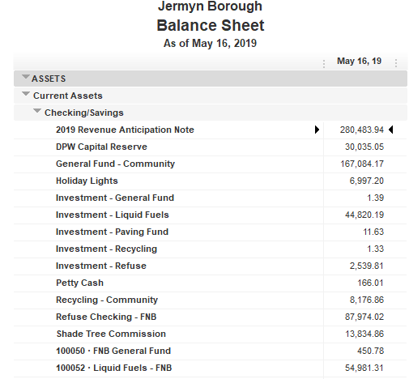

Treasurer’s Report

Slide 4
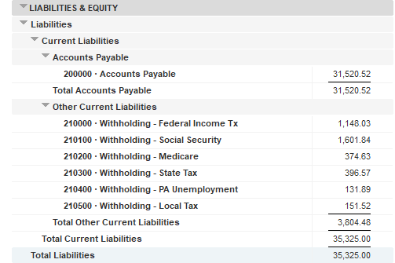

Slide 5
